Slide 1
Aimes Iowa Housing Price Modeling
General Assembly: DSI-6
By: Dmitriy Pavlov
12/07/18

Slide 2
Overview
Data Science Problem
Modeling Procedure
Data Cleaning
Feature Engineering
Modeling
Findings
Recommendations

Slide 3
Data Science Problem: Can we use data to predict housing prices? And if so what are those features and what is their impact?

Slide 4
Modeling Procedure Overview
Data Cleaning
Cleaning null data
Removing outliers
Common sense values test
Feature Engineeing
Explore and transform numerical features
Create new features based on data patterns
Dummy variables from categorical & nominal data
Polynomial transformation
Modeling
Model feature selection
Linear Regression, LASSO, and Ridge
Model evaluation

Slide 5
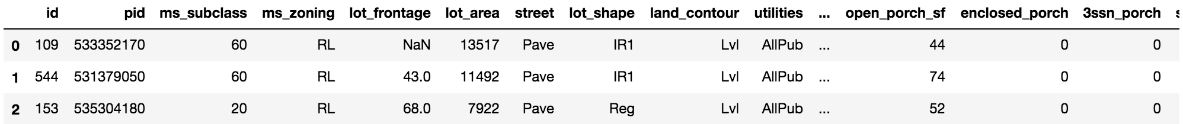
Data Cleaning: Goal is to clean our data and make sure we can trust it going forward
Address null data value and possibly drop the features
Common sense test – do our feature values make sense
Address outliers

Slide 6
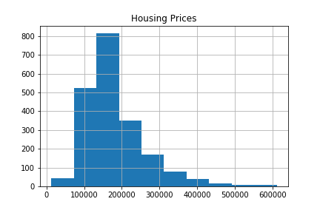
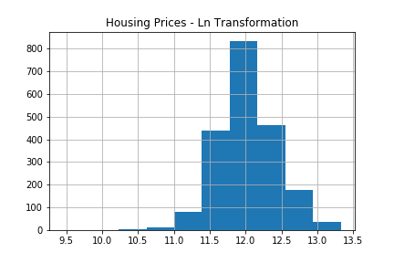
Feature Engineering – Created 28 of my own features via transformations, true/false, and setting level thresholds
Check through histograms and scatter plots vs housing prices to create additional features to help normalize the distributions and better separate the data. Going from 75 to 103 total features.

Slide 7
Feature Engineering – Leverage Python libraries’ functions to explore more possible features
Self-built
103 features
Get_dummies() transformation on
categorical data
276 features
PolynomialFeatures() transformation on all data
38,226 features

Slide 8
Modeling – Lasso model was able to eliminate 98.9% of the features, leaving us with only 400
Lasso Model
α = 0.00619
train r2 = .956
test r2 = .902
c_val = .914
223 useful
features
37,949
features
37,726
useless features

Slide 9
Modeling – We were able to increase model performance when modeling using ‘useful’ features
Lasso Model
α = 0.00198
train r2 = .959
test r2 = .917
c_val = .941
Ridge Model
α = 0.004348
train r2 = .961
test r2 = .912
c_val = .941
test: +1.5 ppts
c_val: +2.7 ppts
test: +1.0 ppts
c_val: +2.7 ppts

Slide 10
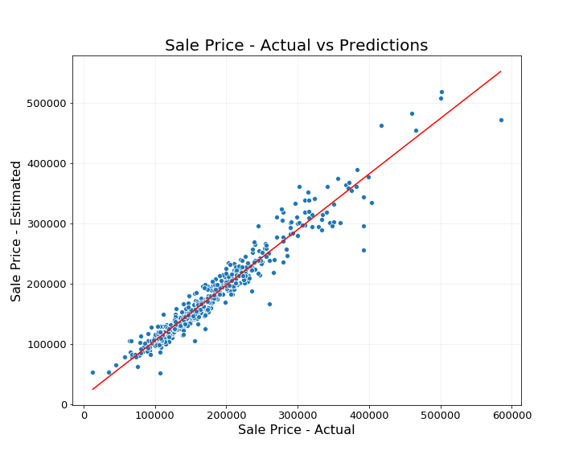
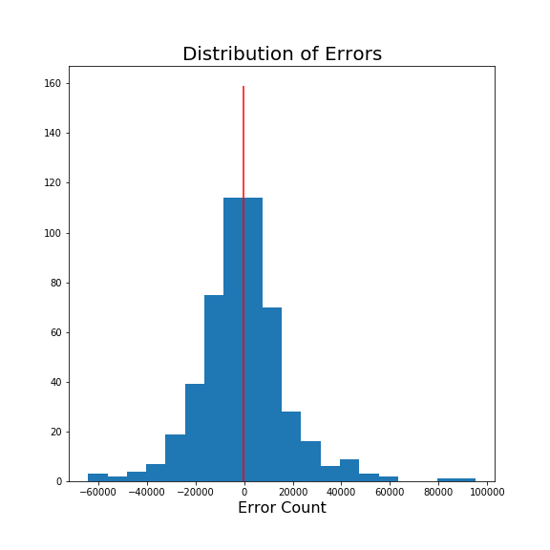
Modeling – The the errors of our model are normally distributed and there are no patterns throughout the graph

Slide 11
Findings – List of top features with positive influence on the sale price of the house
Feature | Explanation | Occurrences
Gr liv area | Above grade (ground) living area square feet | 5
Overall cond | Rates the overall material and finish of the house | 3
Lot Area Log | Lot size in square feet – ln transformed | 3
Year Built | Original construction date | 2
Year Remod/add | Remodel date (same as construction date if no remodeling or additions) | 2
Functional_Typ | Typical Functionality | 2

Slide 12
Findings – List of top features with negative influence on the sale price of the house
Feature | Explanation | Occurrences
Ms Zone C | Commercial zoning classification | 3
Garage Cond Fa | Fair garage condition | 3
Overall Cond | Rates the overall condition of the home | 2
Garage Yr Build | Year garage was built | 2

